Slide 1
Requesting an EHC Needs Assessment
Presented by Essex SEND IASS

Slide 2
What we aim to cover in today's session
What is a Needs Assessment and why my child may need one?
Things to consider
The law around Need Assessments
Who can apply and how to apply for an assessment
Timescales
What happens next – if it is or isn’t agreed

Slide 3
What am I asking for?
An Education Health Care Needs Assessment……….
Which is…….
An assessment of educational health care and social care needs of a child or young person
As defined in the Children and Families Act 2015

Slide 4
What is SEND?
A child or young person has special educational needs if he or she has a learning difficulty or disability which calls for special educational provision to be made for him or her.
Section 20 (1) Children and Families Act 2015

Slide 5
What is an EHCP?
Section 37 Children and Families Act –
(2)For the purposes of this Part, an EHC plan is a plan specifying—
(a)the child's or young person's special educational needs;
(b)the outcomes sought for him or her;
(c)the special educational provision required by him or her;
(d)any health care provision reasonably required by the learning difficulties and disabilities which result in him or her having special educational needs;
(e)in the case of a child or a young person aged under 18, any social care provision which must be made for him or her by the local authority as a result of section 2 of the Chronically Sick and Disabled Persons Act 1970 F1...;
(f)any social care provision reasonably required by the learning difficulties and disabilities which result in the child or young person having special educational needs, to the extent that the provision is not already specified in the plan under paragraph (e).
(3)An EHC plan may also specify other health care and social care provision reasonably required by the child or young person.

Slide 6
Why do I feel my child needs an EHC Needs Assessment?
Child/Young Person (CYP) has recently been diagnosed with a SEND
Gain a better understanding of the gaps within CYP learning
CYP is making less progress than peers at school
School saying there is no funding to support the child
CYP refusal to attend school
CYP emotional wellbeing
School saying they cannot meet child's needs, without an EHCP
Physical disabilities
Medical needs

Slide 7
What difference will an EHCP make for my child/young person?
An EHCP is a legal document, the LA have a duty to make sure the provision in section F is delivered to your CYP.
An EHCP will give your child the access to the specific and/or specialised support they require that can not be given through schools delegated funding.
An EHCP by law should be reviewed annually – this is an opportunity for the family to review the outcomes in section (E), provision (F) and the CYP SEND (B).

Slide 8
Things to consider
Have I spoken to school?
Do we have One Planning in place?
Have school sought advice from external agencies (Educational Psychologist, Inclusion Partner &/or Engagement Facilitator?
Are there up to date reports from specialists and or other professionals to evidence the support and provision for my child?
Section 6.58 of the 2015 Code of Practice states that – “Where a pupil continues to make less than expected progress, despite evidence-based support and interventions that are matched to the pupil’s area of need, the school should consider involving specialists, including those secured by the school itself or from outside agencies”.

Slide 9
Fallacies as to why you shouldn’t make a request
3 rounds of One Planning are needed before requesting the NA
Child is not working 2 years behind chronological age
All children with a diagnosis should have an EHCP
If a parent applies, they are more likely to get one
If I home school my child, I won’t get an EHC plan
The school haven’t spent enough money on my child

Slide 10
What is the Legal Test?
36 (8) Children and Families Act states that:
The local authority must secure an EHC needs assessment for the child or
young person if, after having regard to any views expressed and evidence
submitted under subsection (7), the authority is of the opinion that—
(a) the child or young person has or may have special educational needs,
and
(b) it may be necessary for special educational provision to be made for the
child or young person in accordance with an EHC plan.

Slide 11
About the Legal Test
The test has 2 parts which we refer to on the previous slide. Both of which need to be established if the child or young person is going to be entitled to an assessment:
It is not a requirement that they definitely have SEN only that they may do.
This is sometimes the more difficult aspect of the test, but before going onto how this may be established remember that under the Children & Families Act 2014 Special educational provision is not just about education but education or training which is additional to or different from what is available in mainstream schools in England.

Slide 12
Who can apply for an EHCNA?
Section 36 of the Children and Families Act states that:
The following people have a specific right to ask a local authority to conduct an education, health and care needs assessment for a child or young person aged between 0 and 25:
• the child’s parent/carer
• a young person over the age of 16 but under the age of 25, and
• a person acting on behalf of a school or post-16 institution (this should ideally be with the knowledge and agreement of the parent or young person where possible)

Slide 13
How to Apply
By filling out the ECC parent/carer/young person EHC Needs Assessment request form which can be found on the Essex Local Offer
You could make a written request. – IPSEA Model letter
Making a request for an EHC needs assessment: Model letter 1 | (IPSEA) Independent Provider of Special Education Advice
Send an email stating you wish for the LA to undertake an assessment of your child’s needs
The school or college can also submit a request using the ECC EHCNA request form (also on the Essex Local Offer)
A permissions form will also need to be submitted along with the request (also on the Essex Local Offer)

Slide 14
Evidence

Slide 15
Where to send the information that you want to submit for the EHC NA request: You need to send the information to your area SEND Operations Team: Mid Essex (Braintree, Chelmsford, Halstead and Maldon) SENDOperations.Mid@essex.gov.uk Causeway House, Boking End Braintree CM7 9HB North East Essex (Colchester and Tendring) SENDOperations.NE@essex.gov.uk Essex House, 200 The Crescent, Colchester Business Park, Colchester CO4 9YQ West Essex (Epping, Harlow and Uttlesford) SENDOperations.West@essex.gov.uk Goodman House, Station Rd Harlow, CM20 2ET South Essex (Basildon, Billericay, Brentwood, Castle Point, Rochford and Wickford) EHCRequestSouth@essex.gov.uk Ely House, Churchill Avenue, Basildon SS14 2BQ

Slide 16
If an assessment isn’t agreed
You will receive a letter from the LA
You will be given your rights to appeal and information about mediation
Opportunity for a Way forward meeting

Slide 17
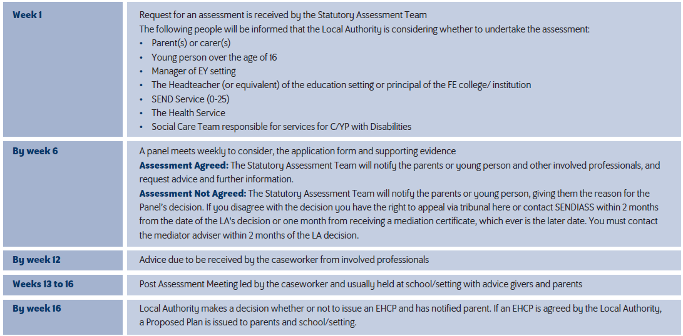
What happens next?

Slide 18
Information gathering
The LA must seek advice from a range of people. The list is set out in Regulation 6(1) of the Special Educational Needs and Disability Regulations 2014 (the “SEN Regs”):
the child’s parent or the young person;
educational advice (usually from the head teacher or principal);
medical advice and information from a health care professional;
psychological advice and information from an educational psychologist;
advice and information in relation to social care;
advice and information from any other person the local authority thinks appropriate;
where the child or young person is in or beyond year 9, advice and information in relation to provision to assist the child or young person in preparation for adulthood and independent living; and
advice and information from any person the child’s parent or young person reasonably requests that the local authority seek advice from.

Slide 19
Outcomes Section E
9.66 of SEND COP 2015 states that - An outcome can be defined as the benefit or difference made to an individual as a result of an intervention… it should be specific, measurable, achievable, realistic and time bound (SMART). When an outcome is focused on education or training, it will describe what the expected benefit will be to the individual as a result of the educational or training intervention provided. Outcomes are not a description of the service being.
The LA are legally required to do this (under section 38 of the Children and Families Act 2014). If you are not happy with any aspect of the draft EHC plan, or the reports attached to it, you can suggest amendments you would like made.

Slide 20
After the Outcomes meeting
Along with the draft EHC plan, the LA must give notice to the parent or young person that they have 15 days in which to:
make comments – ‘representations’ – about the draft EHC plan;
request a meeting with the LA to discuss the draft;
request that a particular school or other institution is named in the final EHC plan.

Slide 21
Naming a school place (Section I)
Types of placements you may be considering:
Maintained school
An academy
Non maintained special school
Independent school
LA has a duty to name the school unless it falls under section 39(4) of the CAFA which states that:
(a)The school or other institution requested is unsuitable for the are, ability, aptitude or special educational needs of the child or young person concerned, or
(b) the attendance of the child or young person at the requested school or other institution would be incompatible with i) the provision of efficient education for others, or ii) the efficient use of resources

Slide 22
Refusal to issue
After the assessment and outcomes meeting have taken place the LA must then decide whether it will issue an EHC plan for the child or young person, this decision is based on the evidence it has gathered as part of the EHC needs assessment.
The LA at this point must refer back to the legal test that we discussed earlier. This can be found in section 37(1) of the Children and Families Act 2014.
Therefore the LA must decide, on the basis of the evidence from the EHC needs assessment, whether it is necessary for the child or young person to have an EHC plan.

Slide 23
Useful links
EHC needs assessments | (IPSEA) Independent Provider of Special Education Advice
EHCP Exemplar Guide 2017.pdf (councilfordisabledchildren.org.uk)
https://view.officeapps.live.com/op/view.aspx?src=http%3A%2F%2Fwww.essexlocaloffer.org.uk%2Fwp-content%2Fuploads%2F2016%2F09%2FEHC-Needs-Assessment-Request-Form-Parent-Carer-or-YP-Dec-21-1.docx&wdOrigin=BROWSELINK
Essex-Permissions-EHCNA-form-2021.docx (live.com)
Asking for an EHC needs assessment | (IPSEA) Independent Provider of Special Education Advice

